Slide 1
FPL Project Presentation Simple Linear Regression Models
By Guillermo Bonilla

Slide 2
Primary Objective
The primary objective of this study is to examine how weather variables influence the electrical demand within Florida Power & Light’s (FPL) service territory. By establishing a statistical relationship or correlation between meteorological factors and power usage, the project seeks to enhance forecasting accuracy and operational planning, particularly in an era marked by shifting climate patterns.
This study will work with two variables at a time using simple linear regression models.

Slide 3
Correlation Analysis
Correlation Analysis is a statistical technique used to analyze relationships between variables. It helps researchers to identify patterns and trends in data and make predictions based on the observed relationships.
A correlation exists between two variables when the values of one variable are somehow associated with the values of the other variables.

Slide 4
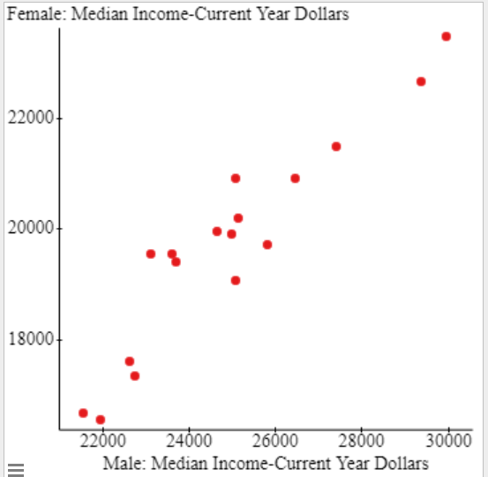
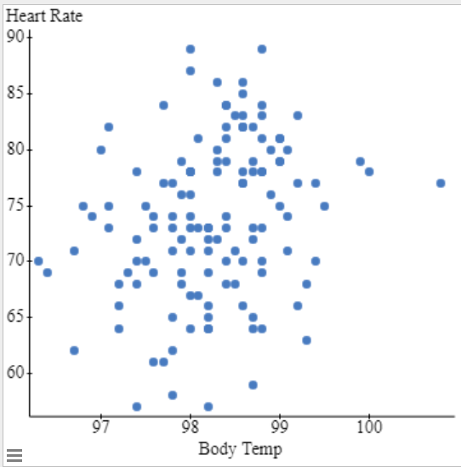
Visualizing Correlation: Scatter Plots
A Scatter Plot is a graphical representation used to display the relationship between two quantitative (numerical) variables, X and Y.
It consists of points (x , y). In a scatter plot, each data point represents a single observation or measurement for both variables.
Scatter plots are very useful for visually identifying patterns, trends, and relationships between variables.

Slide 5
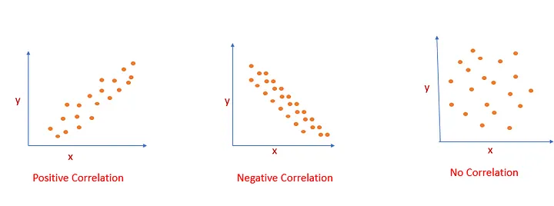
Linear Correlation
A linear correlation exists between two variables when the plotted points of paired data result in a pattern that can be approximated by a straight line.
A positive correlation means that as one variable increases, the other variable also increases.
A negative correlation means that as one variable increases, the other variable decreases.

Slide 6
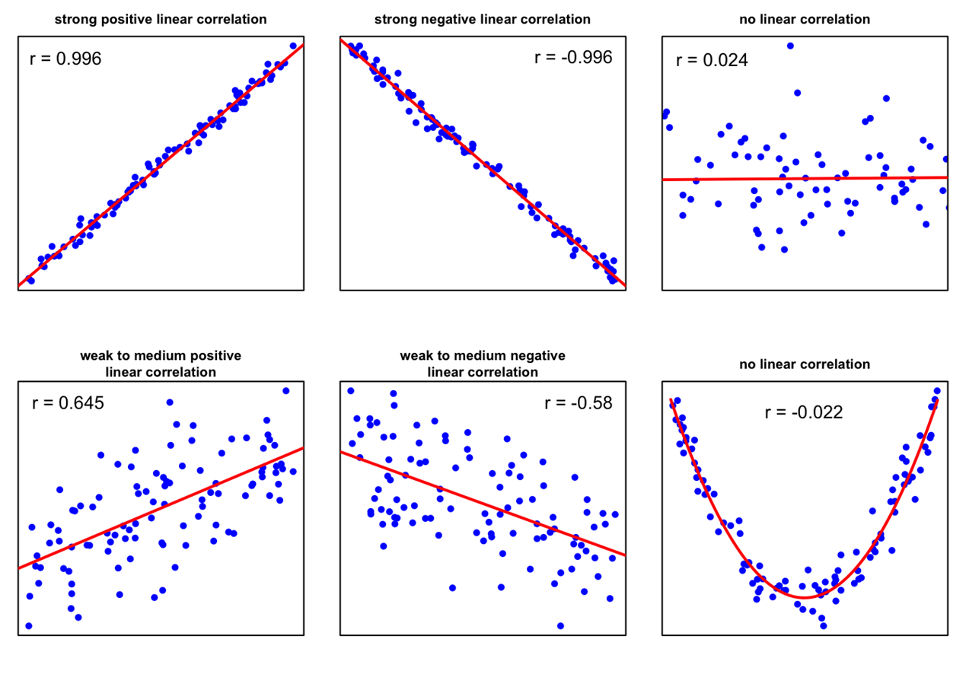
Pearson’s Correlation Coefficient and Scatter plots
Scatter plots may include a trend line or best-fit line that summarizes the overall pattern or trend in the data.
This line is determined using a statistical method called simple linear regression and can be used to make predictions.

Slide 7
My contribution to the project
My contribution involves analyzing simple linear regression models and correlation analysis between meteorological variables and electrical demand and net generation data.
Linear correlation is measured using Pearson's correlation coefficient (r), which quantifies the strength and direction of the linear relationship between two quantitative variables.
If r is close to 1, there is a strong positive linear correlation.
If r is close to -1, there is a strong negative linear correlation.
If r is close to 0, there is no linear correlation between the two variables.

Slide 8
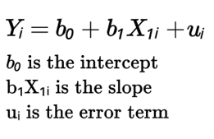
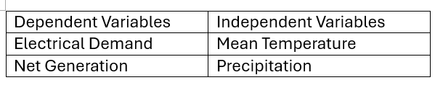
Simple Linear Regression
What Is a Simple Linear Regression Model?
A simple linear regression model predicts a dependent variable Y by fitting a straight line to the data based on a single independent variable X. In essence, it produces a simple two-dimensional relationship, defined by one slope and one intercept.

Slide 9
Hypothesis Testing and Correlation Analysis
In this study, I performed a hypothesis testing procedure to test the claim that there is a linear correlation between the independent and dependent variables. When a strong correlation was found, I obtained the regression equation.
R squared is a value used to measure the goodness of fit of the regression linear model. If the value of R squared is close to one, then the regression model is adequate. If the value of R squared is close to zero, then the regression model is inadequate.

Slide 10
Electrical Demand and Net Generation Data
The electrical demand data used in this study were sourced from the U.S. Energy Information Administration (EIA) database focusing on FPL data.
Link: Real-time Operating Grid - U.S. Energy Information Administration (EIA)
This comprehensive dataset comprises a daily time series capturing several key variables. The datetime variable records the specific day at which measurements were taken, while the demand (measured in MWh) represents the actual electricity consumption for each recorded day. Additionally, the dataset includes forecasted demand values, which facilitate a direct comparison between predicted and actual load, as well as metrics for net generation (MWh).

Slide 11
Meteorological Data
Meteorological observations were obtained from the Florida State University (FSU) Climate Center, which captures daily weather information from numerous stations across Florida.
Link: Downloadable Data - Florida Climate Center
Each record in the dataset is associated with a specific weather station and an observation date, formed by merging the separate YEAR, MONTH, and DAY fields into a logical date format.
The dataset includes daily measurements of precipitation, recorded in either inches or millimeters, along with temperature metrics that capture the maximum, minimum, and average daily temperatures.

Slide 12
Data Coverage
Using the data from both sources, simple linear regression models were created to showcase a positive linear correlation between demand and mean temperature in 2019, 2020, 2021, 2022, 2023, and 2024 found in ten separate Florida locations (e.g., Ft. Lauderdale, Hialeah, Melbourne, Miami, Daytona Beach, Miami Beach, Vero Beach, Naples, Kissimmee, and Ft. Lauderdale Beach.)

Slide 13
Data Coverage Cont.
I obtained two separate models for each year and each location using the following dependent variables.
Y → Daily Electrical Demand
Y → Daily Net Generation
For both models the independent variable used was:
X →Daily Mean Temperature
X → Daily Precipitation
For the purposes of the presentation, I will show results from the top 12 locations with the highest Pearson correlation coefficient and R squared values for the years 2019 and 2024.

Slide 14
Methodology
The technology I used Excel, where I used spreadsheets. This included the statistical analysis tool packs, where I used Regression, and the Pearson coefficient options.

Slide 15
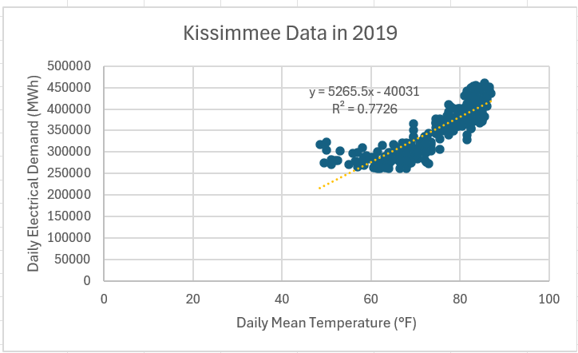
Kissimmee 2019 Electrical Demand vs Mean Temperature Simple Linear Regression Model
A set of 313 observations were used to find the regression equation.
The Pearson correlation coefficient between these two variables is 0.87.
A linear regression model is shown here between the daily electrical demand and daily mean temperature in Kissimmee in 2019. The equation of the line is
y = 5265.5x - 40031,
and the R squared value is 0.7726.

Slide 16
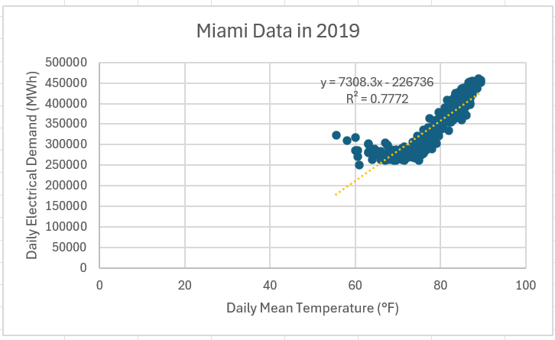
Miami 2019 Electrical Demand vs Mean Temperature Simple Linear Regression Model
A set of 365 observations were used to find the regression equation.
The Pearson correlation coefficient between these two variables is 0.88.
A linear regression model is shown here between the daily electrical demand and daily mean temperature in Miami in 2019. The equation of the line is
y = 7308.3x - 226736,
and the R squared value is 0.7772.

Slide 17
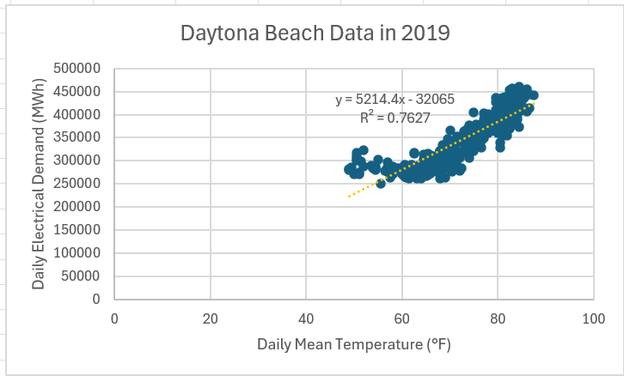
Daytona Beach 2019 Electrical Demand vs Mean Temperature Simple Linear Regression Model
A set of 359 observations were used to find the regression equation.
The Pearson correlation coefficient between these two variables is 0.87.
A linear regression model is shown here between the daily electrical demand and daily mean temperature in Daytona Beach in 2019. The equation of the line is
y = 5214.4x - 32065,
and the R squared value is 0.7627.

Slide 18
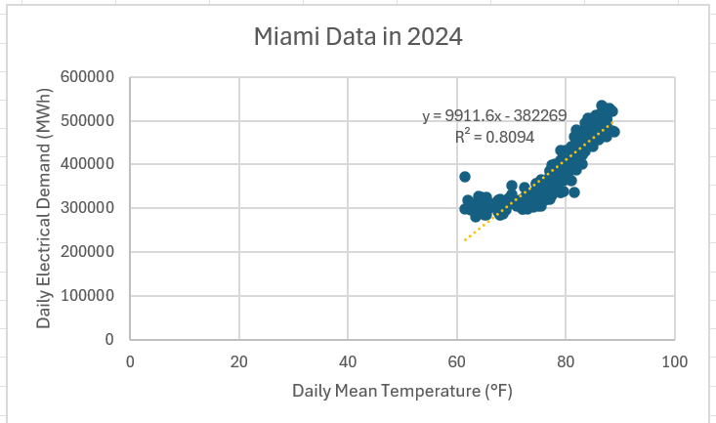
Miami 2024 Electrical Demand vs Mean Temperature Simple Linear Regression Model
A set of 366 observations were used to find the regression equation.
The Pearson correlation coefficient between these two variables is 0.90.
A linear regression model is shown here between the daily electrical demand and daily mean temperature in Miami in 2024. The equation of the line is
y = 9911.6x - 382269,
and the R squared value is 0.8094.

Slide 19
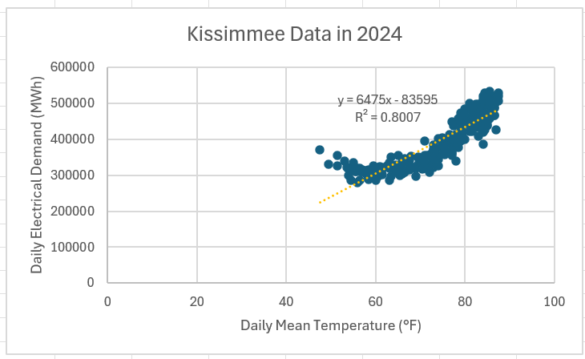
Kissimmee 2024 Electrical Demand vs Mean Temperature Simple Linear Regression Model
A set of 330 observations were used to find the regression equation.
The Pearson correlation coefficient between these two variables is 0.89.
A linear regression model is shown here between the daily electrical demand and daily mean temperature in Kissimmee in 2024. The equation of the line is
y = 6475x - 83595,
and the R squared value is 0.8007.

Slide 20
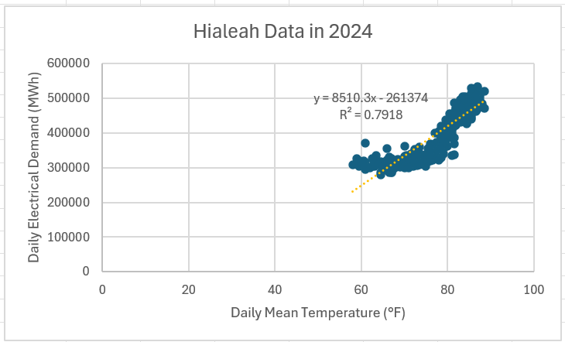
Hialeah 2024 Electrical Demand vs Mean Temperature Simple Linear Regression Model
A set of 324 observations were used to find the regression equation.
The Pearson correlation coefficient between these two variables is 0.89.
A linear regression model is shown here between the daily electrical demand and daily mean temperature in Hialeah in 2024. The equation of the line is
y = 8510.3x - 261374,
and the R squared value is 0.7918.

Slide 21
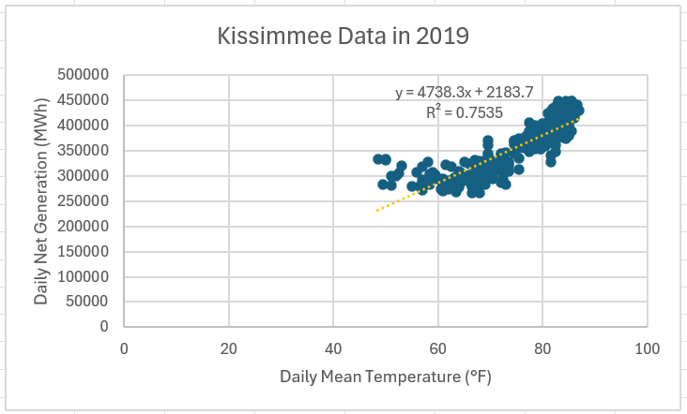
Kissimmee 2019 Net Generation vs Mean Temperature Simple Linear Regression Model
A set of 313 observations were used to find the regression equation.
The Pearson correlation coefficient between these two variables is 0.87.
A linear regression model is shown here between the daily net generation and daily mean temperature in Kissimmee in 2019. The equation of the line is
y = 4738.3x - 2183.7,
and the R squared value is 0.7535.

Slide 22
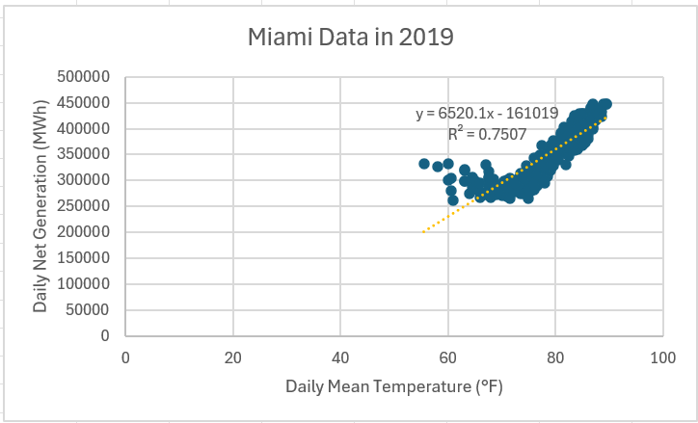
Miami 2019 Net Generation vs Mean Temperature Simple Linear Regression Model
A set of 365 observations were used to find the regression equation.
The Pearson correlation coefficient between these two variables is 0.87.
A linear regression model is shown here between daily net generation and the daily mean temperature in Miami in 2019. The equation of the line is
y = 6520.1x - 161019,
and the R squared value is 0.7507.

Slide 23
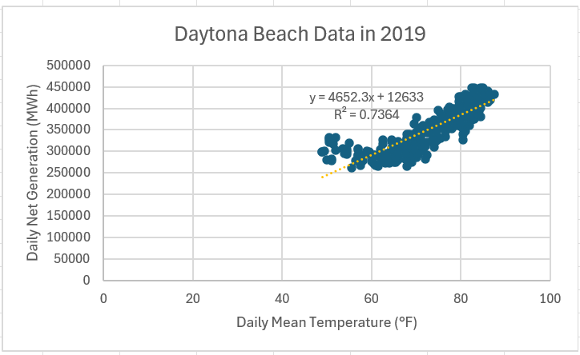
Daytona Beach 2019 Net Generation vs Mean Temperature Simple Linear Regression Model
A set of 359 observations were used to find the regression equation.
The Pearson correlation coefficient between these two variables is 0.86.
A linear regression model is shown here between the daily net generation and daily mean temperature in Daytona Beach in 2019. The equation of the line is
y = 4652.3x + 12633,
and the R squared value is 0.7364.

Slide 24
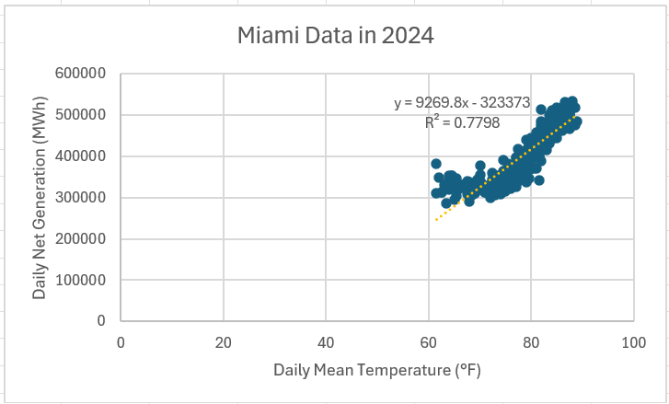
Miami 2024 Net Generation vs Mean Temperature Simple Linear Regression Model
A set of 366 observations were used to find the regression equation.
The Pearson correlation coefficient between these two variables is 0.88.
A linear regression model is shown here between the daily net generation and daily mean temperature in Miami in 2024. The equation of the line is
y = 9269.8x - 323373,
and the R squared value is 0.7798.

Slide 25
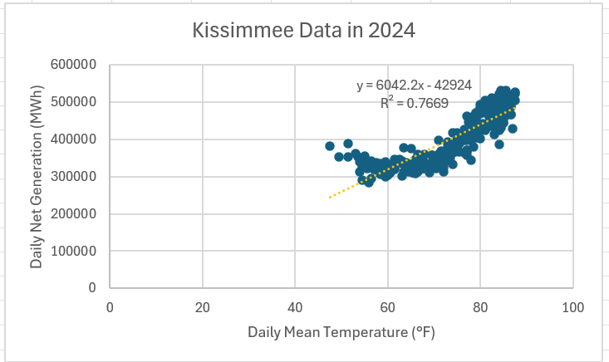
Kissimmee 2024 Net Generation vs Mean Temperature Simple Linear Regression Model
A set of 330 observations were used to find the regression equation.
The Pearson correlation coefficient between these two variables is 0.88.
A linear regression model is shown here between the daily net generation and daily mean temperature in Kissimmee in 2024. The equation of the line is
y = 6042.2x - 42924,
and the R squared value is 0.7669.

Slide 26

Ft. Lauderdale 2024 Net Generation vs Mean Temperature Simple Linear Regression Model
A set of 364 observations were used to find the regression equation.
The Pearson correlation coefficient between these two variables is 0.87.
A linear regression model is shown here between the daily net generation and daily mean temperature in Ft. Lauderdale in 2024. The equation of the line is
y = 8396.7x - 246755,
and the R squared value is 0.7585.

Slide 27
Additional Findings Cont.
The independent variable precipitation (measured most likely in inches) was also analyzed briefly in separate models across demand and net generation. These models overall showed weak positive linear correlation. Moreover, very weak R squared values and weak Pearson coefficients were outputted as well. This is shown in the following graphs.

Slide 28
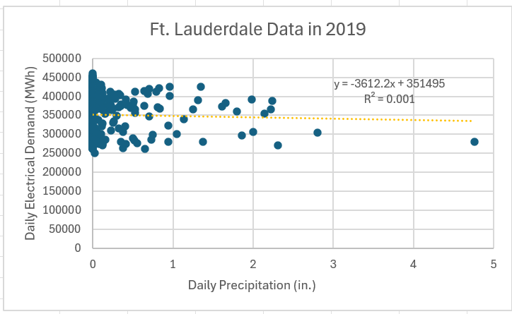
Electrical Demand vs Precipitation Example
A set of 359 observations were used to find the regression equation.
The Pearson correlation coefficient between these two variables is -0.03.
A linear regression model is shown here between the daily electrical demand and daily precipitation in Ft. Lauderdale in 2019. The equation of the line is
y = -3612.2x - 351495,
and the R squared value is 0.001.

Slide 29
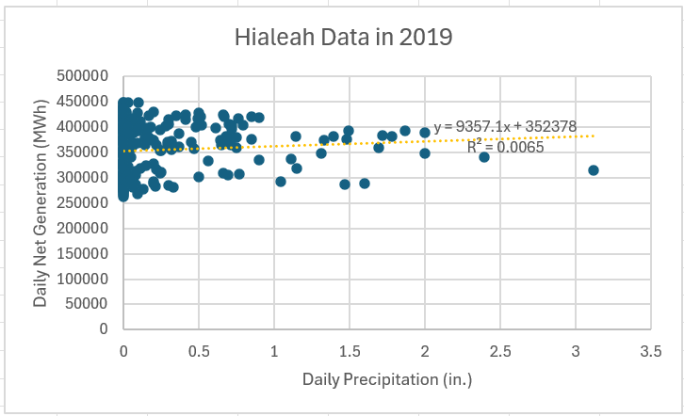
Net Generation vs Precipitation Example
A set of 332 observations were used to find the regression equation.
The Pearson correlation coefficient between these two variables is 0.08.
A linear regression model is shown here between the daily net generation and daily precipitation in Hialeah in 2019. The equation of the line is
y = 9357.1x + 352378,
and the R squared value is 0.0065.

Slide 30
Main Conclusions
According to the statistical outputs, the results show there is a strong positive linear correlation between mean temperature and electrical demand, and between mean temperature and net generation.
There is also evidence for more electrical consumption when temperatures rises in each of the ten Florida locations.
Conversely, there is less electrical consumption when temperature is lower in each of the ten cities.
Also, by including more variables in the linear regression model will increase the goodness of fit indicator or R squared coefficient. In the next presentation, this will be further discussed.
In addition, the results show that cities comprised of much tourism and coastal areas and higher population exhibit stronger positive linear correlation due to the higher R squared and Pearson coefficient values.

Slide 31
Works Cited
Elementary Statistics 14th edition
Mario F. Triola Chapter 10 Correlation and Regression
U.S. Energy Information Administration (EIA) database focusing on FPL data
Link: Real-time Operating Grid - U.S. Energy Information Administration (EIA)
Meteorological observations were obtained from the Florida State University (FSU) Climate Center, which captures daily weather information from numerous stations across Florida.
Link: Downloadable Data - Florida Climate Center

Slide 32
Questions?

